Slide 1
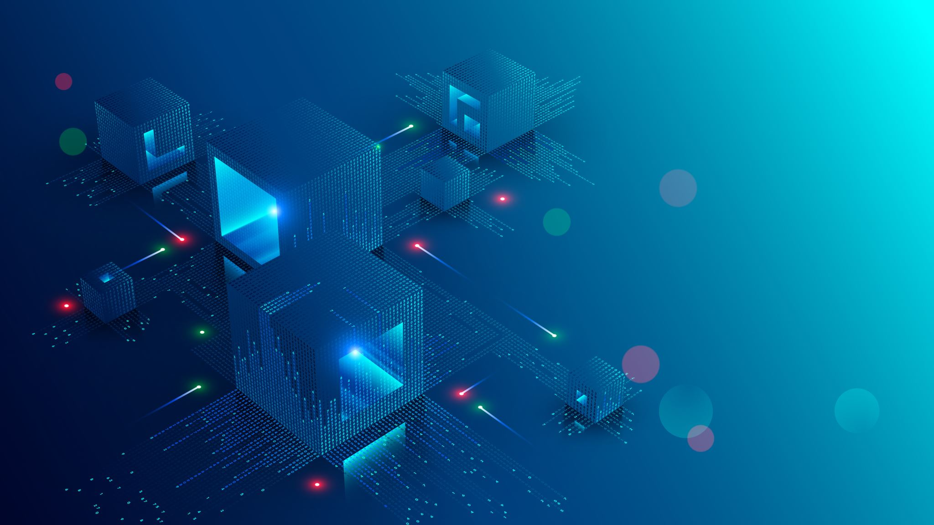
Side-Channel Attacks
The threats beyond Cryptographic algorithm
Luan Vo (30553600)
University of Massachusetts Amherst
ECE 547 – Professor Wayne Burleson
Notes:
I decided on this topic, partly because SCA is the only real/practical thing I had done so far in this class. In addition, I spent a large amount of time for the project, because I will be utilizing a lot of what I had learned during the process of that assignment for this project. Which was also why I had a section for related works included within that project, as I wanted to dig deeper, in preparation for the final project.
I also went an extra step in the DPA assignment to attempt at some extra trials that I will further elaborate in the essay.

Slide 2

Introduction to Side Channel Attacks (or SCA)
“The idea that power consumption of a circuit is a function of the data.”
- Professor Wayne Burleson, 2020
Notes:
The quote that best summarize the nature of side-channel attack. I will attempt the dissect this quote at later slides and why it is so important.
I will also be using the Kocher paper as reference, but that is a given since it is a required reading, I will not count it towards my total papers, but I will be referencing it when I work on my essay.
Image source: https://www.google.com/url?sa=i&url=https%3A%2F%2Ftwitter.com%2Fgannimo%2Fstatus%2F1030165529674346502&psig=AOvVaw2UgQz6seo9y1uILopfDKm-&ust=1592369194077000&source=images&cd=vfe&ved=0CAIQjRxqFwoTCICRh8PFheoCFQAAAAAdAAAAABAD

Slide 3
What is side-channel attack? According to “Introduction to Side-Channel Attacks and Fault Attacks” by Yang Li et al [1] and “Side-channel Attacks” by Swarup Bhunia et al [2] and “Resilience Against Physical Attacks” by Martin Hutle et al [3]
“Side-channel attacks and fault attacks use the physical interactions with cryptographic devices to achieve the shortcuts of recovering the secret key.” [1]
This method of attack was first introduced by Kocher in 1996 [2]. The attackers observe the hardware activities when cryptographic activities are underway. Through this additional information, it is possible to crack the system protective cryptographic algorithm (in software) by exploiting the various weakness in its implementation (hardware or other).
Since it does not directly aim at the main defensive cryptographic algorithms, that is why these type of attacks are coined side-channel attacks.
This is due to: “In mathematical cryptanalysis, the security of cryptographic primitives is discussed under a black-box model, where only plaintexts and ciphertexts are available to the attackers.”[1]
While being able to protect plaintexts and ciphertexts has their own has their own merits, as the field of cryptoanalysis is a large and complicated field. However, such study assume that the intermediate (i.e: hardware) is a black-box model, such is not the case in practical application, as we have seen with this method of attack.
Side-channel attacks are classified along two axes: invasive vs. non-invasive and active vs. passive; though most side-channel attacks are non-invasive [1,2]
Notes:
I believe that that having a firm base knowledge is important, that is why I chose my papers from very basic then more advanced as I dig deeper. Besides, doing this will help me organize my final paper.
My format will be: take important quotes from each paper, then dig deeper with my own explanation.
Note to self: [2] https://www.sciencedirect.com/topics/computer-science/side-channel-attack#:~:text=4.2.,of%20cryptographic%20algorithms%20or%20software.

Slide 4
Why is it dangerous?
Aside from its effectiveness, “non-invasive attacks usually do not leave obvious attack evidence, thus it is difficult to track back to the attackers.”[1]
Unlike software-based attacks, one can trace the attackers via digital footprint (i.e: IP address, MAC address, etc), hardware objected to side-channel attacks may not leave such obvious signs of being tampered, and worse, without a witness it is nearly impossible to determine who the attacker was.
“The attackers manipulate the devices with any available equipment to extract the information of the intermediate calculation results.” [1]
Unlike cracking a software security, which is both time-consuming, costly and consume a large amount of computational resources¹(i.e: public-private key algorithm). Instead of spending hundred of trillions years to solve a set of cryptographic algorithm, a well-executed side-channel attack only need days or weeks.
In addition to its deadly effectiveness, one can easily manipulate a piece of hardware to act a certain way, which is worrying. Since most hardware are made with consumers’ ease-of-use in mind, thus, making a large portion of hardware being used today left dangerously undefended.
Unlike software, which is a battlefield of wits and resources, hardware has the inherent weakness (among many more practical issues²) that is production vs cost relationship.
Notes:
1: time-consuming and costly because one has to go through jungle of code and its library, and it requires very sophisticated understanding of the software in order to crack it. (that doesn’t mean side-channel requires any less skill, but it is undeniable that hacking a system requires in-depth knowledge, and a cryptographic algorithm can contain up to billions combinations that could take trillions of years to solve, such as the public-private key algorithm)
2: After reading all the papers, I realized that one of the reason why security is so difficult is often the conflict of interests between companies-consumers-developers (engineers). It truly is a complex field and I cannot even begin to fathom where the issues originate from. Since it is an interconnected web of this relationship in the real world, it makes security engineering extremely a difficult field.

Slide 5
Types of side-channel attack
There are many forms of side-channel attacks, some of the most generally used are [3]:
Timing attacks: Computers communicate through a clock cycle, which means that each computational operation has its own timing and clock cycle/response. By manipulating these cycles and get an accurate reading, one will be able to understand which processes are being run or how a computer’s response to a certain input.
Power Analysis attacks: In this technological age, mostly everything is powered by electricity. Which also means that for each operation that a machine executes, it also consumes a necessary amount of power needed for that operation. By looking at power consumption it has proven to be terribly effective in cracking computers’ cryptographic algorithm.
EM-attacks: Aimed at the EM emissions that arise from data-dependent current flows inside a device. This method works much better since it is possible to observe much faster signals than with other conventional method for side-channel attacks. Can even measure devices even without having physical contact with them.

Slide 6
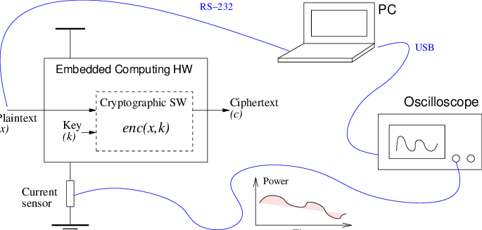
A simplified illustration of SCA
Notes:
I believe that nothing capture human’s understanding that pictures and graphs, since our brain is limited by nature.

Slide 7
SCA through power consumption in a nutshell According to “Introduction to differential power analysis” by Paul Kocher et al [4] and “Power Analysis Attacks to Cryptographic Circuits: a Comparative Analysis of DPA and CPA” by Massimo Alioto et al [5]
There are many variations of SCA methods aimed at power consumption, but I will especially focus in Differential Power Analysis and its variant – Correlated Power Analysis.
Among the available methods of SCA, DPA and CPA are amongst the most popular and widely used due to their ease-of-use, and generally can be done by anyone with limited/simple set of equipment.
This can be done with a simple use of an oscilloscope, probes and resistors (refer to the graph in slide 6 for practical application). The data collected during this process are called power consumption traces.
These traces show the system’s power consumptions and activities at the time of capture. With this data set, one can run tests and determine the cryptographic algorithms of the system.
The simplicity poses a threat to industry as SCA is not resource intensive, meaning that just about anyone with sufficient knowledge or bad intentions can damage the product in some ways.

Slide 8
Differential Power Analysis (or DPA)
As the name suggested, DPA relies on the differencing the average power waveform between sets of data. This is to find the data-dependent correlations that exist within these waveforms. As with any statistical analysis, DPA is susceptible to noise if the trace samples are not sufficiently large enough when compared to the existing noise/jitter, as it will cause some disturbance and inconsistency in the DPA process.
In addition, we need to make sure that the part of power consumption that is being examined is only the data-dependent part. That is to say, the power consumption of the system’s cryptographic algorithm, not the entire circuit¹. [5]
According to Alioto et al: “From the previous considerations, DPA (CPA) attacks are successful if the spike obtained with the correct guess can be distinguished from the others.”² [5]
This spike is a presentation of the correlation between the collected sample of power estimation and the measured power consumption. The magnitude of the spike is the waveform presentation of this correlation, the more correlation there is, the higher the spike’s magnitude and vice versa.
Notes:
1: Therefore, aside from learning how to use power analysis, one must also be able to learn how to extract these AES traces from the hardware.
2: This is extremely important! While not explicitly being said, if the noise level exceed that of the spike, no correlation can be understood! This will be further elaborate in later slides
Note: In this section, I will explain the things that I learned that was not explicitly being told in class, but was hinted at through the lectures/readings

Slide 9
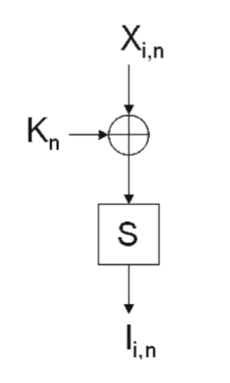
Correlated Power Analysis (or CPA)
“CPA involves evaluating the degree of correlation between variations within the set of measurements and a model of device leakage that depends on the value of (or a function of) one or more intermediates in the cryptographic calculation.”¹ [4]
Unlike DPA, CPA does not necessarily compare the correlation of power consumption, instead, CPA seeks to compare the correlation between the leakage model of theoretical and measured system.
In the picture from the right²: the leakage model is S-Box. However, it could be many other things (such as Last Round State leakage), but it usually falls into the calculation of Hamming weight/distance³ mathematical model. Because of this dependency on input leakage model, “CPA works best in white-box analysis.” [4,5]
This is because, during the mathematical process of combining of K (secret key) and X (plaintext) there are some intermediate leakages pertaining to that specific system. The combination of these elements then produce I (ciphertext).
Notes:
1: this is arguably the most important and most misunderstood concept of CPA. Personally, I had to read the extra papers in order to have a good grasp of what it is.
2: taken from paper [3]
3: Further explained in next slide

Slide 10
Hamming weight and CMOS According to “Correlation Power Analysis with a Leakage Model” by Eric Brier et al [6]
“Classically, most power analyses found in literature are based upon the Hamming weight model, that is the number of bits set in a data word” [6]
Hamming weight model is a method that is widely used within communication system where it determines how far apart two (binary) data words are. In other words, we are trying to determine how many bits are getting turned on and off during the execution of cryptographic algorithms, since it is generally assumed that the current consumption correlates with the number of bits that need to be flipped from one state to the next.
This way of thinking is possible since a microprocessor could be modeled as a state-machine, and each state transitions are triggered by events (such as clock signal) [6]. This is due to the behavior of a CMOS can sometimes be very similar to that of a switch (by switching from low to high state).¹
Individually, each transistor may act in a non-linear fashion, but on a whole, the larger hardware obeys this linear model quite well².
In addition to the linearity, it is worth noting that we only want the energy consumption of the data-dependent part and not the entire circuit’s power consumption. If the power traces contain non-data-dependent parts, it could lead to the incorrect answer as there exist noises within the traces.
Notes:
1: refer to next slide
2: Unlike a single transistor, the micro-processor does fit the linear model, for example: a microprocessor behaves in a predictable way that could be observed and most importantly. These devices (chips, microprocessors, etc), in general, don’t act in a random fashion, and tends to stay organized – since if they are random, computing would be a nightmare.

Slide 11
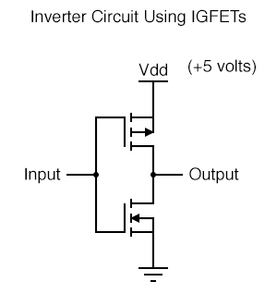
CMOS illustration
CMOS: a combination of both NMOS and PMOS.
If input is low, output is high.
If input is high, output is low
Due to this “switch-like” behavior, we can make a correlation between the current consumption and state of the device.
Notes:
While this is elementary, I want to be thorough in my documentation

Slide 12
SCA challenges – noise and distortion
“The idea that power consumption of a circuit is a function of the data.”
This means that if data could be modeled as a function of power consumption, it also means that such function could be distorted via an introduction of an erroneous variable – such as noise.
Noise virtually exists in every system and is often the source of uncontrollable and unavoidable variable within a system. Thus, the accuracy of a function or model will drop as noise exceeds the tolerable level.
Since SCA follows a linear model, noise will prove to be a fatal, as it will influence with the data distribution, thus making it difficult to accurately analyze the trend line. If the trace samples are not sufficiently large enough when compared to the existing noise, it will cause disturbance and inconsistency in the SCA process.
Due to this, many have considered using noise (or a source of randomness) to mask the energy consumption of data-dependent parts – in order to fool adversaries. Adding noise will make the trace capturing process more difficult, as well as complicates the trace analyzing process.
Notes:
Note: a mathematical function will only hold true if they have considered all of the extra elements that could hamper the calculating process. Thus by saying that a power consumption is a function of the data, meaning that the function must have taken all of this extra information into account.
Note: Noise is very important, because most of these processes are very sensitive (correlation and differentiating), and it is the most powerful variable in this process. As it can be a wall to stop adversaries. And noise here does not only mean electrical disturbances, it stands for all the noisy variables that can complicates the analyzing process.
Note: I might add PUFs as a counter measures against SCA

Slide 13
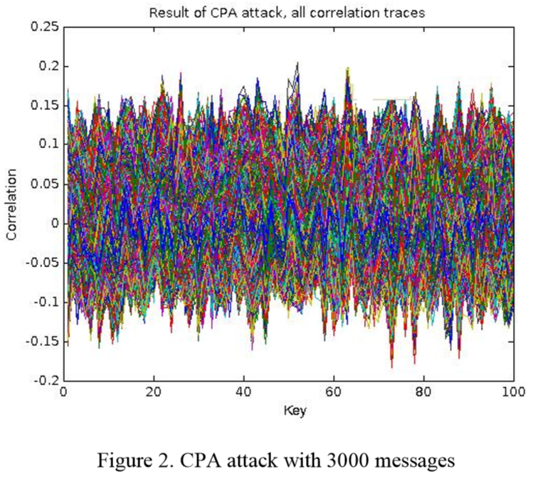
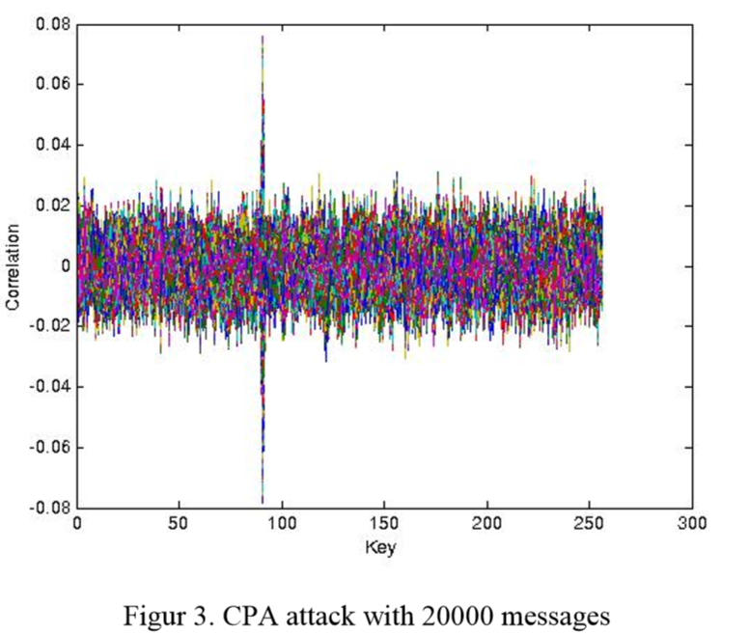
Graph of CPA attacks with varying traces
As shown in the graphs, by increasing traces the correct correlation is much more distinctly visible
Notes:
Note: This has to do with the SNR (signal to noise ratio), which I will elaborate further in my paper, though generally, 3000 traces are still too small for accurate reading – even by normal standards.
Graphs from: “Implementation of CPA analysis against AES design on FPGA” by Noura Benhadjyoussef et al

Slide 14
How to prevent SCA According to “Side-Channel Attacks Ten Years After Its Publication and the Impacts on Cryptographic Module Security Testing” by YongBin Zhou et al [7]
When combatting SCA, there have been many proposals, some of which are:
“de-correlate the output traces”, “replace critical assembler instructions”, and “algorithmic changes to the cryptographic primitives so that attacks are provably inefficient on the obtained implementation” [7]
However, software-based countermeasures remains to be widely used, due to its flexibility, and in many contexts, cheapest to be put into practical uses.
There are two primary ways (but not limited to) in which SCA can be combatted: masking and hiding
Both of which seeks to introduce randomness and noise into the system in order to make the process of retrieving and analyzing much more difficult.
This can be done via an introduction of a dummy variable, randomization process, etc. In other words, any process that is able to hide the intermediate step of cryptographic algorithm (as this remains to be the biggest data leakage that SCA attacks make use of) [7]
However, in order to obtain this, one must be able to create a reliable source of RNG.
Notes:
Note to self: Side channel attack 10 years, page 12 for noise injection defense mech

Slide 15
DPA vs CPA
DPA, by comparison, works much better than CPA since it does not require an input leakage model. CPA is generally restricted by the leakage model that is known to the users, thus, if the model was not registered in a library, an attack could not be executed.
However, DPA is much more susceptible to noises when compared to CPA, since DPA relies on the average, and data distributions to find correlations. Such weakness is due to the nature of difference in mean statistical analysis.
This means that the larger the sample set, the lower the sampling error [4] and so will our distribution trend. According to Massimo Alioto et al, “DPA attacks need on the average a number of collected power traces that is 30% greater than that required by CPA attacks.” [5].

Slide 16
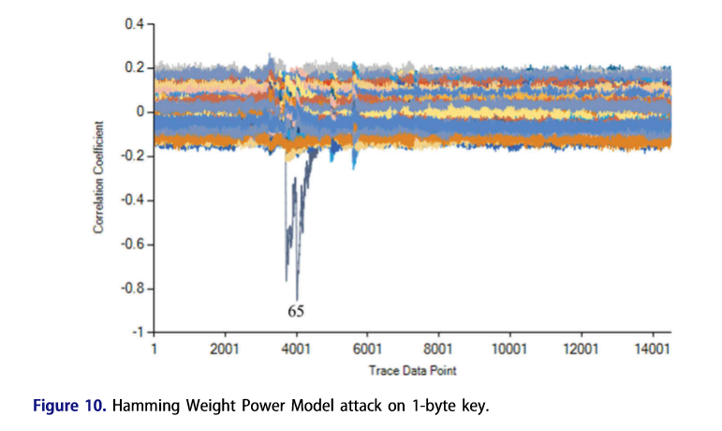
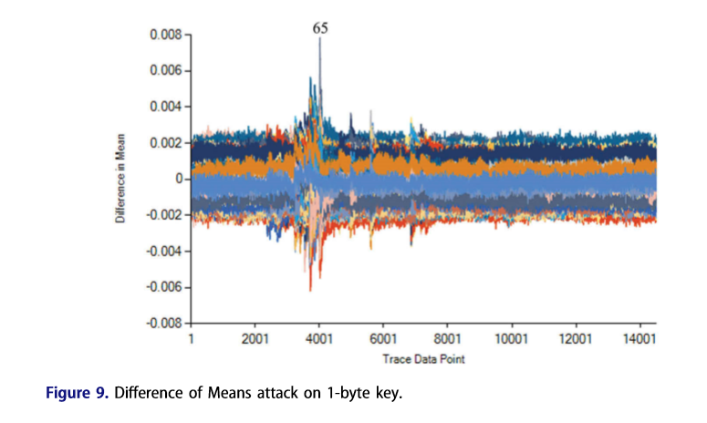
Graph of CPA vs DPA
We see that, while both method was able to extract the correct key, however, it is much more visible in CPA. Whereas in DPA, we see much noises around the correct key, this is also known as the “ghost peaks”
Notes:
Graphs from: “Power analysis attacks on the AES-128 S-box using differential power analysis (DPA) and correlation power analysis (CPA)” by Owen Lo et al
Note to self: “Correlation Power Analysis with a Leakage Model” ghost peaks

Slide 17
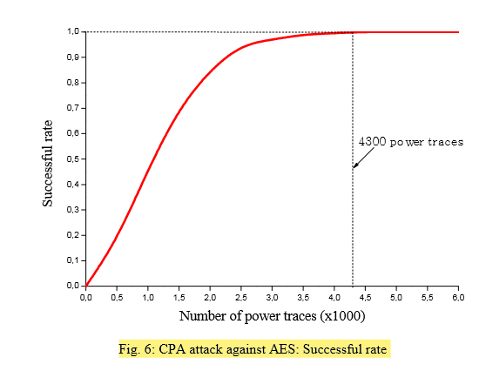
CPA effectiveness against AES
As illustrated from the picture to the right, with the current AES, CPA would only need around 4300 power traces in order to successfully crack the encryption.
It means that while CPA lacks in sophistication when compared to DPA, however, in a white-box analysis, CPA will likely outperform DPA in terms of resources being used and accuracy.

Slide 18
Objective
My objective is to test the various attacks on a given trace file, dig deeper into the analyses of SCA and especially focus on the potential of CPA attacks against AES system.
This project also seeks to determine the effect of noise in SCA process. With the given trace file, what is the tolerable SNR?
What exactly is a leakage model, and what does it mean in the context of white-box analysis.
Seeks to further understanding of CPA method and process via Chipwhisperer.
Notes:
Note: Though I want to perform DPA attacks as well, I will attempt to look around CW for potential. But if you know where I can find the default for DPA, please let me know. I am sorry for the inconvenience, and thank you very much!

Slide 19
Method
I will first run a few controlled (default) attacks against the trace files.
Then beginning to mount extra noises within the system and observe the difference that it makes.
Dissects and understands the algorithm of CPA as well as connecting the theory from the readings into actual technical code.
Forms experimental groups that will then be compared with the controlled group. The experimental group will mostly focus on different leakage model of CPA, varying in noise level.

Slide 20
Rationale
The reason behind this method is first, to test the validity of preexisting texts and study’s claim in regard to this subject. While it is a well-known and well-studied subject, nevertheless, there are always room for improvement in every system.
In order to propelled further into understanding security, one must have a firm base. I believe that the basic knowledge does not mean that they are easy to understand, instead, they are the absolute foundations in which much more difficult and in-depth studies are built upon.
Thus my goal is to test the current theory and understandings, as well as testing my understanding regarding the current subject. In order to achieve this, I will be performing various attacks of different models and noise, which I will be documented and based my conclusions from.
Lastly, I also chose this because my major is EE, and that this aspect of SCA really fascinates me.

Slide 21
Results
Due to limited resources from the ongoing situation, I will base my project from DPA assignment and dive further into what we haven’t covered during that assignment.
So far, the result was that CPA was able to successfully extract the key from trace files but was left unanswered regarding the noise and why the traces are AES. Also, while we did touch on why some attacks failed, there was never much explanation behind it. So I want to explore all the other leakage models that we did not cover during the assignment.
And most importantly, being able to analyze the graphs and data that resulted after each attacks (which we did not cover much at all during the assignment)
There exist a definite relationship between CMOS (or transistors) and SCA which was briefly mentioned.

Slide 22
Reflections and further works
After the initial assignment, I was left amazed at how such attacks are made possible from such seemingly small amount of available information. After the proposal of SCA around the year of 2000, SCA has become much more diverse and complex. As an EE, it caught my attentions and SCA’s dangerous potential is seemingly endless and only being limited by our imagination.
I found that, there were many things that were left for better explanations in regard to SCA, especially:
Noise in SCA
CMOS
Leakage model
CPA vs DPA
Correlation (Hamming distance/weight)
Energy consumption
All of which has been briefly mentioned in this presentation and I hope to better explain these aspects in future works.

Slide 23
Citation
[1]: Y. Li, M. Chen, and J. Wang, “Introduction to side-channel attacks and fault attacks,” 2016 Asia-Pacific International Symposium on Electromagnetic Compatibility (APEMC), 2016. https://ieeexplore-ieee-org.silk.library.umass.edu/document/7522801
[2]: S. Bhunia and M. H. Tehranipoor, “Side-Channel Attacks,” in Hardware security: a hands-on learning approach, Cambridge, MA, MA: Morgan Kaufmann, an imprint of Elsevier, 2019, pp. 193–218. https://www.sciencedirect.com/topics/computer-science/side-channel-attack#:~:text=4.2.,of%20cryptographic%20algorithms%20or%20software.
[3]: F. Skopik, P. Smith, M. Hutle , and M. Kammerstetter, “Resilience Against Physical Attacks,” in Smart grid security innovative solutions for a modernized grid, Waltham, MA, MA: Elsevier, 2015, pp. 79–112. https://www.sciencedirect.com/topics/computer-science/side-channel-attack#:~:text=4.2.,of%20cryptographic%20algorithms%20or%20software.

Slide 24
Citation (cont’d)
[4]: P. Kocher , J. Jaffe , B. Jun, and P. Rohatgi, “Introduction to differential power analysis,” SpringerReference, Mar. 2011. http://citeseerx.ist.psu.edu/viewdoc/download?doi=10.1.1.225.3481&rep=rep1&type=pdf
[5]: M. Alioto, M. Poli, and S. Rocchi, “Power analysis attacks to cryptographic circuits: a comparative analysis of DPA and CPA,” 2008 International Conference on Microelectronics, 2008. https://ieeexplore-ieee-org.silk.library.umass.edu/document/5393827
[6]: E. Brier, C. Clavier, and F. Olivier, “Correlation Power Analysis with a Leakage Model,” Lecture Notes in Computer Science Cryptographic Hardware and Embedded Systems - CHES 2004, pp. 16–29, 2004. https://link.springer.com/chapter/10.1007/978-3-540-28632-5_2

Slide 25
Citation (cont’d)
[7]: Y. Zhou and D. G. Feng, “Side-Channel Attacks: Ten Years After Its Publication and ...,” Research Gate, 2005. [Online]. Available: https://www.researchgate.net/publication/220333749_Side-Channel_Attacks_Ten_Years_After_Its_Publication_and_the_Impacts_on_Cryptographic_Module_Security_Testing. [Accessed: 18-Jun-2020]. https://eprint.iacr.org/2005/388.pdf

Slide 26
Related works
H. Mestiri, F. Kahri, B. Bouallegue, and M. Machhout, “A CPA attack against cryptographic hardware implementation on SASEBO-GII,” 2017 International Conference on Green Energy Conversion Systems (GECS), 2017. https://ieeexplore-ieee-org.silk.library.umass.edu/document/8066139
F. R. Nuradha, S. D. Putra, Y. Kurniawan, and M. A. Rizqulloh, “Attack on AES Encryption Microcontroller Devices With Correlation Power Analysis,” 2019 International Symposium on Electronics and Smart Devices (ISESD), 2019. https://ieeexplore-ieee-org.silk.library.umass.edu/document/8909447
N. Benhadjyoussef, H. Mestiri, M. Machhout, and R. Tourki, “Implementation of CPA analysis against AES design on FPGA,” 2012 International Conference on Communications and Information Technology (ICCIT), 2012. https://ieeexplore-ieee-org.silk.library.umass.edu/document/6285774
Notes:
Note: these are not directly mentioned (yet) but my knowledge was inferred from these readings as well

Slide 27
Related works (cont’d)
O. Lo, W. J. Buchanan, and D. Carson, “Power analysis attacks on the AES-128 S-box using differential power analysis (DPA) and correlation power analysis (CPA),” Journal of Cyber Security Technology, vol. 1, no. 2, pp. 88–107, 2016. https://www.tandfonline.com/doi/full/10.1080/23742917.2016.1231523

